Slide 1



Building Text-Based Applications with the ChatGPT API & LangChain
How to build LLM apps
Lucas Soares
21-08-2023

Slide 2

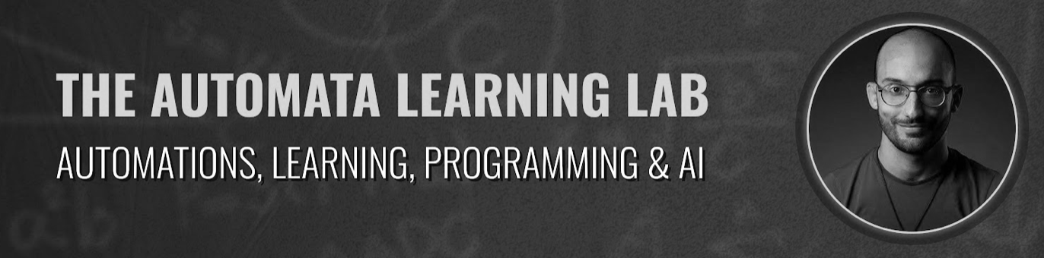
Intro
Hi!
Me!
Quick Survey to get to know everyone!

Slide 3
Quick Survey to get to know everyone!

Slide 4
Large Language Models
A definition
LLMs are advanced AI systems designed to understand and generate human language.

Slide 5
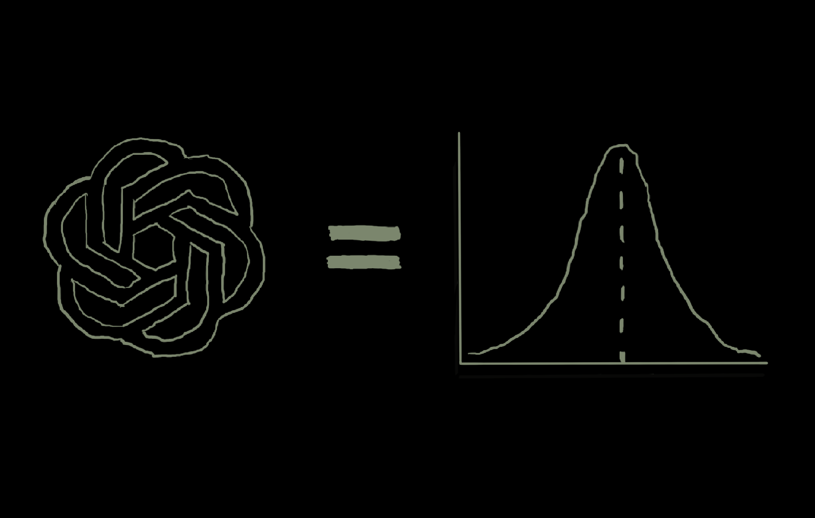
Large Language Models
A definition
LLMs are advanced AI systems designed to understand and generate human language.
They assign probabilities to words based on context, allowing them to predict future words in a sentence.

Slide 6
Large Language Models
As Probability Distributions
At their core, LLMs can be seen as distributions over words.

Slide 7
Large Language Models
As Probability Distributions
At their core, LLMs can be seen as distributions over words.
Use statistical models to capture patterns in text data.

Slide 8
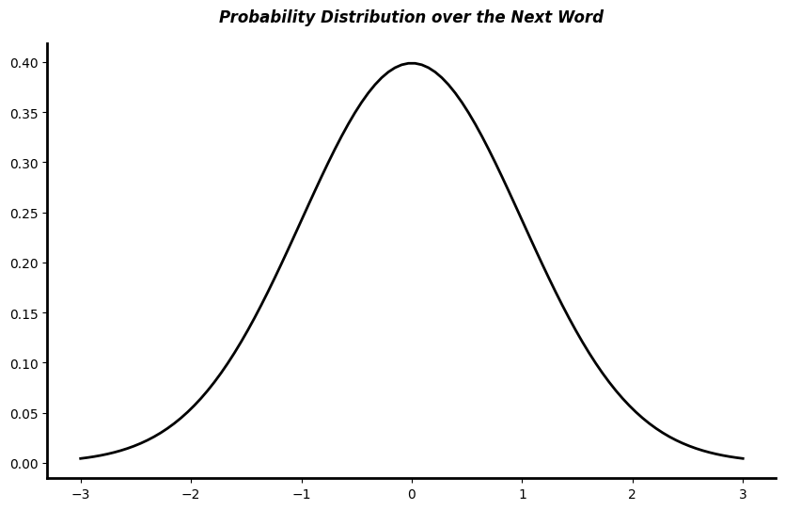
Large Language Models
As Probability Distributions
Probability Distribution over the Next Word
At their core, LLMs can be seen as distributions over words.
cake
Use statistical models to capture patterns in text data.
bread
fruit
They calculate the likelihood of each word occurring given the context.
pie
pasta
“I love eating….” → ?

Slide 9
Large Language Models
As Probability Distributions
Probability Distribution over the Next Word
At their core, LLMs can be seen as distributions over words.
cake
Use statistical models to capture patterns in text data.
bread
fruit
They calculate the likelihood of each word occurring given the context.
pie
pasta
“I love eating….” → ?
Notes:
Pizza joke

Slide 10
Large Language Models
N-gram models
Unigram model: each token/word is independently modeled.
Notes:
For instance, given the sentence "When the bough breaks, the cradle will fall," the unigram model assigns probabilities to each word without considering the order or context.

Slide 11
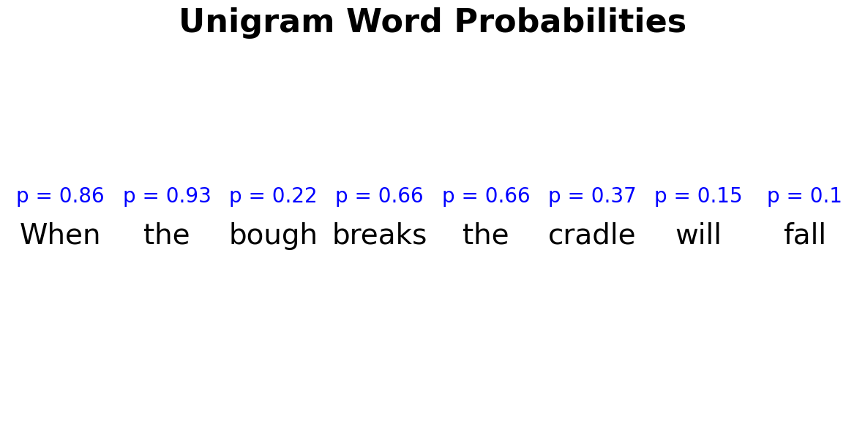
Large Language Models
N-gram models
Unigram model: each token/word is independently modeled.
Sentence S = "When the bough breaks, the cradle will fall."
Notes:
For instance, given the sentence "When the bough breaks, the cradle will fall," the unigram model assigns probabilities to each word without considering the order or context.

Slide 12
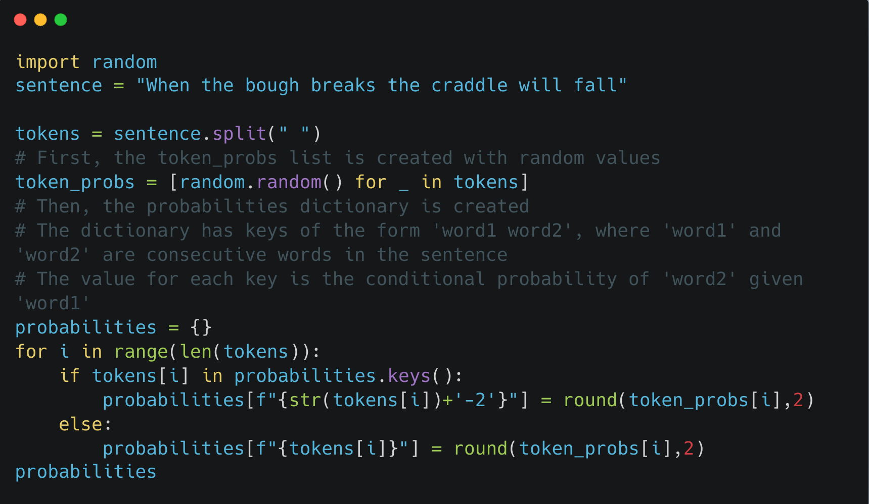

Large Language Models
N-gram models

Slide 13
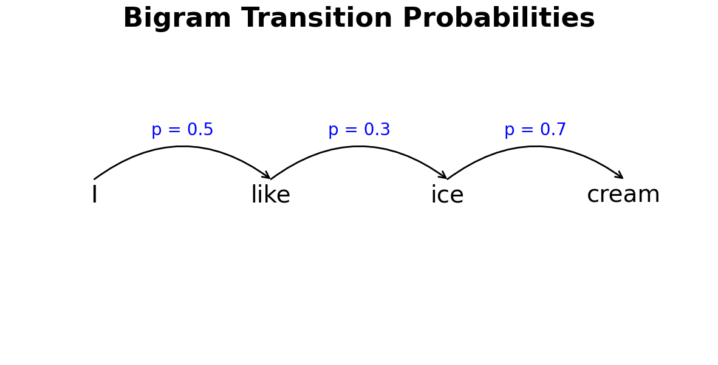
Large Language Models
N-gram models
Bigram model, the probability of a word depends on its previous word.
Sentence S = "I like ice cream."
The probability of the sentence is the product of the individual probabilities:
$$P(\text{"}\text{I}\text{like}\text{ice}\text{cream}\text{"})=P(\text{"}\text{I}\text{"})×P(\text{"}\text{like}\text{"}|\text{"}\text{I}\text{"})×P(\text{"}\text{ice}\text{"}|\text{"}\text{like}\text{"})×P(\text{"}\text{cream}\text{"}|\text{"}\text{ice}\text{"})$$
Can't capture long term relationships
Notes:
For instance, given the sentence "When the bough breaks, the cradle will fall," the unigram model assigns probabilities to each word without considering the order or context.

Slide 14
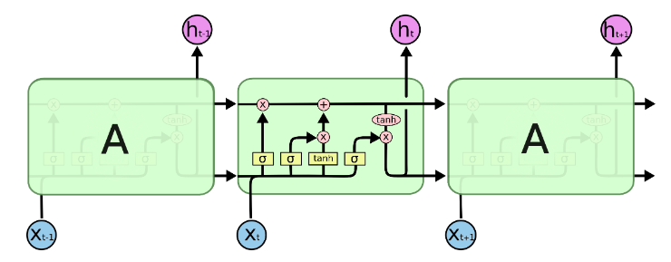
Large Language Models
Sequence to Sequence Models: LSTMs
LSTMs, forgetting mechanism to model longer sentences and maintain context.
(Hochreiter and Jürgen Schmidhuber 1997)
Forgetting gates and context maintenance.
Understanding LSTM Networks by Christopher Olah
The probability of the sentence now is influenced by context
Notes:
they decide what to store, what to forget, and what to output, allowing them to maintain context, ensuring distant words or concepts can influence understanding."

Slide 15
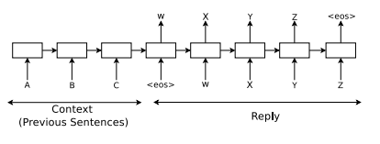
Large Language Models
Sequence to Sequence Models: LSTMs
Seq2Seq models require processing input sequentially
Struggle with really long complex inputs
(Vinyals & Le, 2015)
Can't capture really long contexts!
Notes:
they decide what to store, what to forget, and what to output, allowing them to maintain context, ensuring distant words or concepts can influence understanding."

Slide 16
The complexity of language models increases to account for their ability to consider context when modeling sequences of text.

Slide 17
Essence of LLMs
Beyond pattern matching
They capture context, understand dependencies, and predict text based on patterns learned during training.

Slide 18
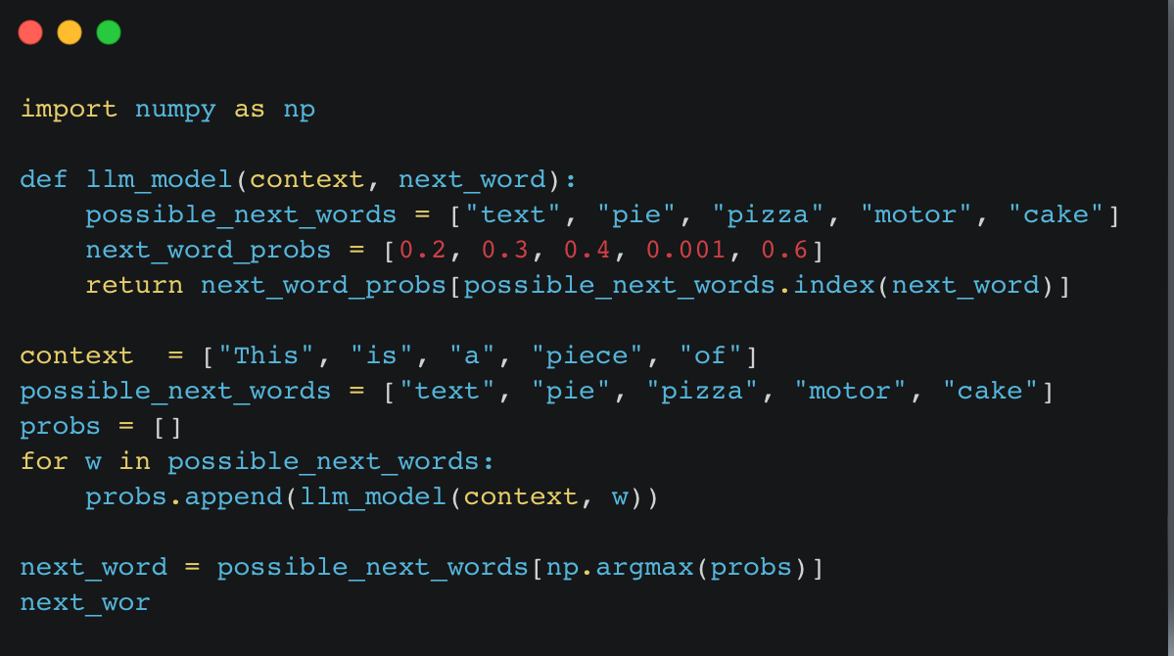
Ok, but how?
LLMs as pattern matchers
LLMs are akin to probabilistic programs.
They predict outcomes based on probabilities learned from training data

Slide 19
Context/Past
LM
Future
Notes:
In essence, a language model is a model that takes in some context about the past in terms of tokens, words, or sentences and tries to predict the likelihood of a token, word or sentence in the future, allowing it to model complex processes like text generation.

Slide 20
How LLMs work
Transformers Architecture
Traditional sequential models struggle with context (Vaswani et al 2017)
Transformers use attention mechanisms to capture global dependencies, enabling contextual understanding. (Vaswani et al 2017)
The attention mechanism allows Transformers to focus on different parts of input simultaneously. (Vaswani et al 2017)
Transformers can understand and predict based on long-range dependencies. (Vaswani et al 2017)

Slide 21
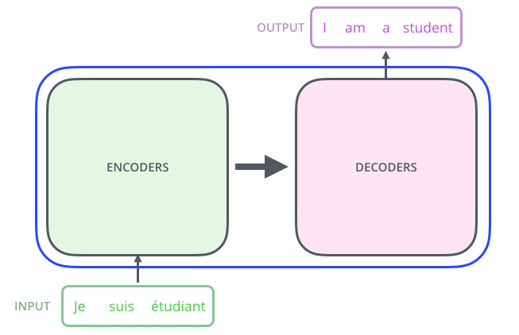
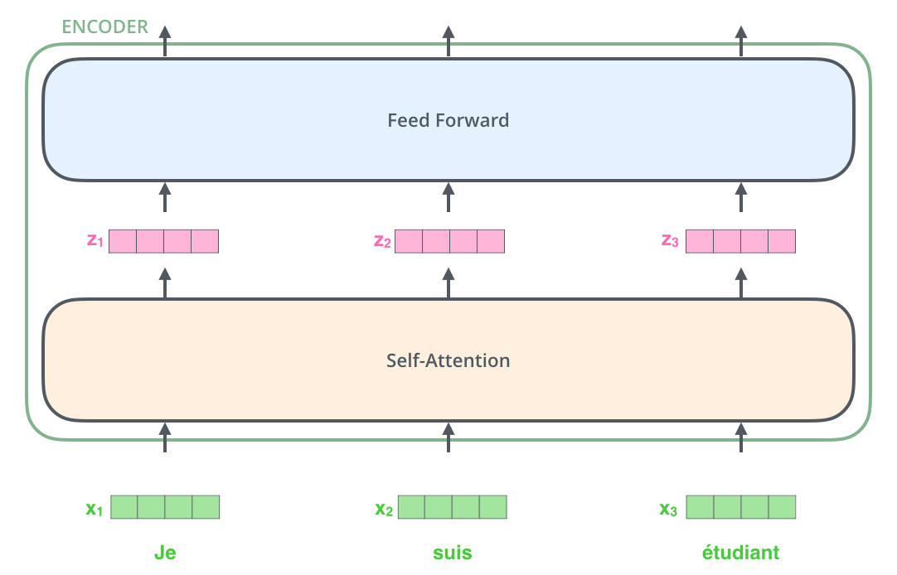
How LLMs work
Transformers Architecture
Inputs are processed in parallel!

Slide 22
How LLMs work
Transformers Architecture

Slide 23
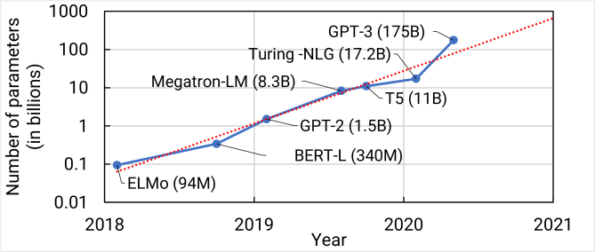
Why “Large” Language Models?
Large → Big number of parameters

Slide 24
Benefits of Large Language Models
Multi-task, fine tuning, scalability
Multi-task Capability: LLMs find applications in content generation, question answering, translation, tutoring, and personal assistants.
Fine-tunning: LLMs can usually be fine tuned with a relatively small amount of data, making them adaptable to a wide range of tasks.
Scalability: LLMs demonstrate excellent scalability to very large capacity networks and huge datasets.
Notes:
They transform how we interact with technology, making tasks like writing articles or answering questions more efficient.

Slide 25
Applications of Large Language Models
Content generation
Q&A
Translation
Tutoring
Personal Assistants

Slide 26

Applications of LLMs
Content generation Example - DEMO

Slide 27
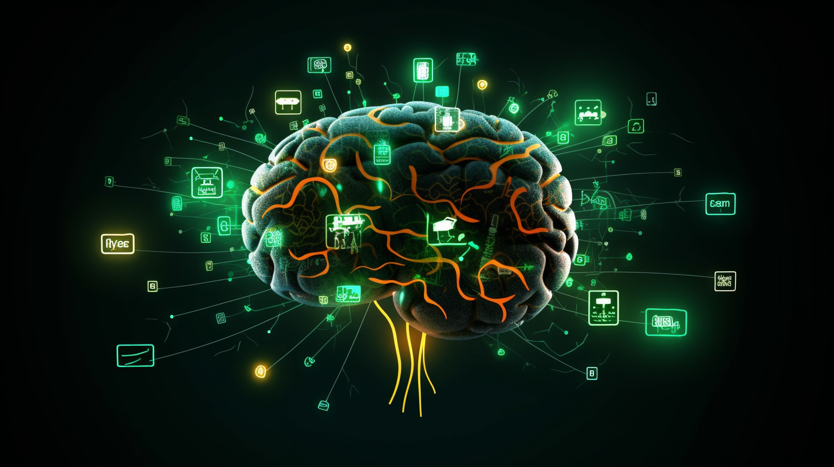
Applications of LLMs
Translation Example - DEMO

Slide 28
Limitations and Ethical Considerations
LLMs are far from perfect
Knowledge Limit: LLMs have a cutoff point for their knowledge.
Understanding Limit: LLMs do not understand text in the same way humans do. They don't have beliefs or desires; they simply predict what comes next based on their training.
Misuse: LLMs can hallucinate and produce false or harmful content
Reproducibility: Unpredictability of LLM behavior. Watkins 2023
Data Privacy and Bias: Ethical considerations should extend to the acquisition of data for training additional models. Models may have biases; their use should be transparent and biases mitigated. Watkins 2023
Notes:
Knowledge Limit: LLMs have a cutoff point for their knowledge, based on when they were last trained. They cannot learn or update their knowledge after this point.
Understanding Limit: LLMs do not understand text in the same way humans do. They don't have beliefs or desires; they simply predict what comes next based on their training.
Misuse: Misinformation (as they can generate plausible-sounding but false information), and the potential for misuse (like generating harmful or offensive content).
D. Reproducibility: Although LLMs can be directed by fine-tuning parameters and "prompt engineering", there are no reliable techniques to fully control their behavior. This unpredictability can limit the reproducibility of research results, challenging the fundamental scientific principle of replicability. Watkins 2023
E. Data Privacy and Protections: Ethical considerations should extend to the acquisition of data for training additional embedding models used in LLM workflows. Ensuring transparency and respect for privacy rights in the process is paramount. Watkins 2023
F. Bias and Transparency: LLM-generated results may carry inherent biases based on the training data. Researchers must be cognizant of this and actively work to identify and mitigate such biases. The process of using LLMs should be transparent, with clear descriptions of all the tools and techniques used. Watkins 2023

Slide 29
Questions and Discussion

Slide 30
Introduction to prompt engineering and the ChatGPT API
1
Prompt basics
3
Prompt engineering guide
Best practices for writing effective prompts
2
Introduction to the ChatGPT API
4

Slide 31
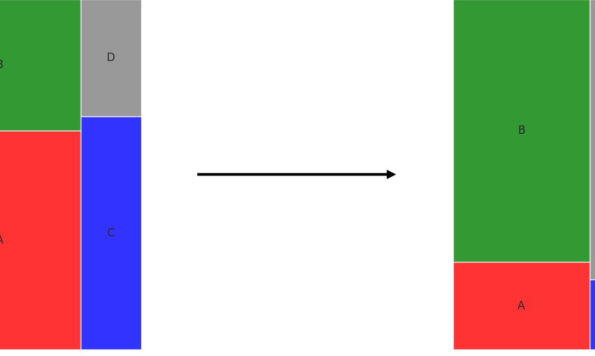
1
Prompt Basics
A prompt is a piece of text that conveys to the LLM the user’s intention.
LLM Text Space
LLM Text Space after prompt
prompt
Question → Instruction → Behavior
It constrains the space of possibilities in the LLM's text space

Slide 32
1
Components of a prompt
Task, input, context, style
Context information: background info on what you are requesting, the data you are providing etc
Task description: where you describe what you want
Prompt style: Its about how you ask the thing you want to the model
Input data: data the model has not seen to illustrate what you need

Slide 33
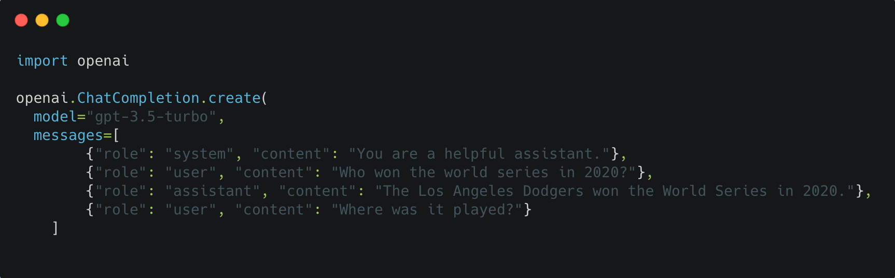
2
Introduction to the ChatGPT API
Where does ChatGPT fit in this chaotic LLM universe?
2
The ChatGPT API allows us to use OpenAI's chat models to generate dynamic, contextually-aware responses.
Required parameters: model, messages.

Slide 34
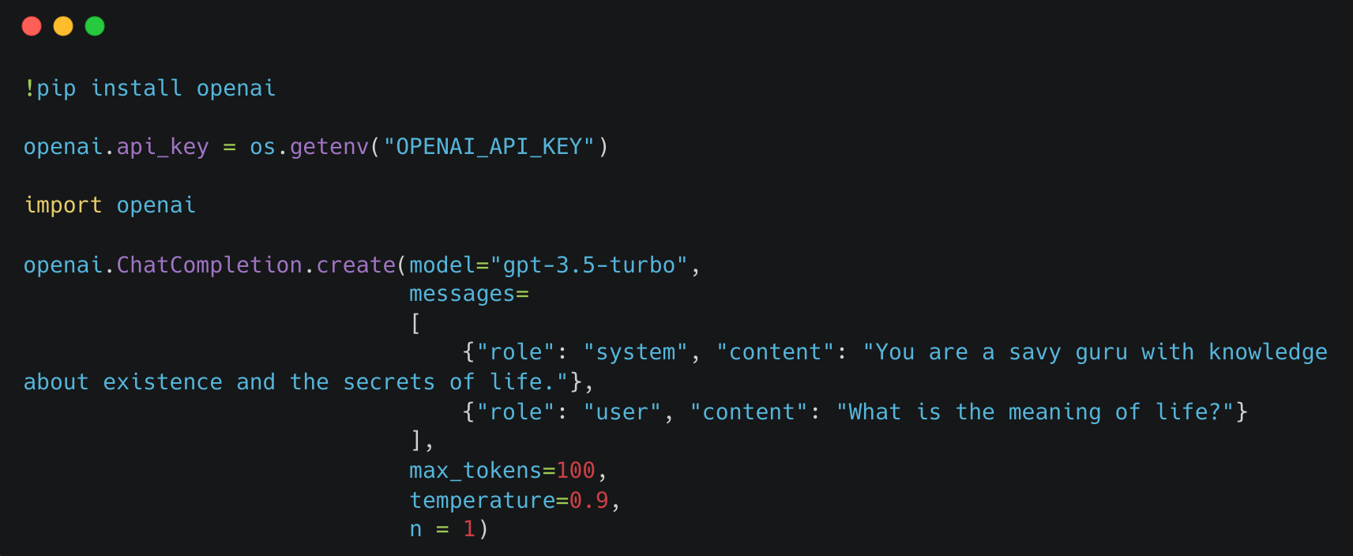
2
Introduction to the ChatGPT API
Where does ChatGPT fit in this chaotic LLM universe?
2

Slide 35
2
Introduction to the ChatGPT API
Where does ChatGPT fit in this chaotic LLM universe?
2

Slide 36
2
Introduction to the ChatGPT API
Where does ChatGPT fit in this chaotic LLM universe?
2

Slide 37
2
Introduction to the ChatGPT API
Where does ChatGPT fit in this chaotic LLM universe?
2

Slide 38
2
Introduction to the ChatGPT API
Where does ChatGPT fit in this chaotic LLM universe?
2

Slide 39
2
Introduction to the ChatGPT API
Where does ChatGPT fit in this chaotic LLM universe?
2

Slide 40
2
Introduction to the ChatGPT API
Where does ChatGPT fit in this chaotic LLM universe?
2

Slide 41
2
Introduction to the ChatGPT API
Where does ChatGPT fit in this chaotic LLM universe?
2

Slide 42
2
Introduction to the ChatGPT API
Where does ChatGPT fit in this chaotic LLM universe?
2

Slide 43
2
Introduction to the ChatGPT API
Where does ChatGPT fit in this chaotic LLM universe?
2

Slide 44
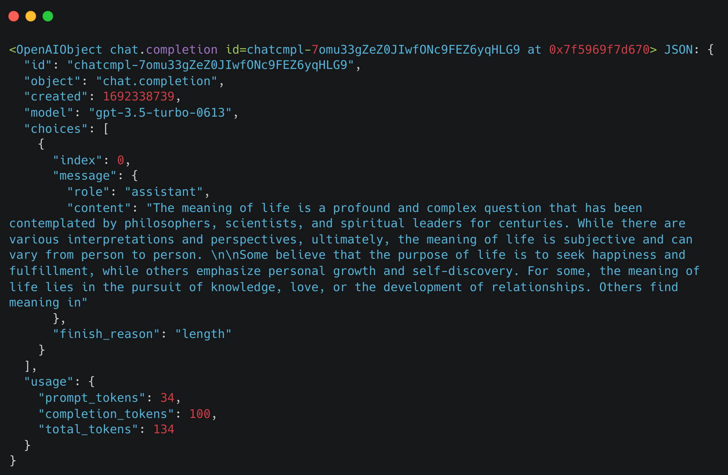
2
Introduction to the ChatGPT API
A breakdown of the response
2

Slide 45
2
Introduction to the ChatGPT API
A breakdown of the response
2

Slide 46
2
Introduction to the ChatGPT API
A breakdown of the response
2

Slide 47
2
Introduction to the ChatGPT API
A breakdown of the response
2

Slide 48
2
Introduction to the ChatGPT API
A breakdown of the response
2

Slide 49
2
Introduction to the ChatGPT API
A breakdown of the response
2

Slide 50
2
Introduction to the ChatGPT API
A breakdown of the response
2

Slide 51
2
Introduction to the ChatGPT API
A breakdown of the response
2

Slide 52
2
Introduction to the ChatGPT API
A breakdown of the response
2

Slide 53
2
Introduction to the ChatGPT API
A breakdown of the response
2

Slide 54
2
Introduction to the ChatGPT API
A breakdown of the response
2
Notebook demo

Slide 55
Prompt Engineering Guide
3
What is prompt engineering?
Prompt engineering: discipline for engineering prompts
Means by which LLMs can be programmed through prompting.
Process of creating a prompting function that results in the most effective performance on the downstream task.
The basic goal of prompt engineering is designing appropriate inputs for prompting methods.
Notes:
discipline concerned with establishing the rules for obtaining the most deterministic outputs possible from a LLM by employing engineering techniques and protocols to ensure reproducibility and consistency.

Slide 56
Prompt Engineering Techniques
3
A simplified guide of prompting techniques
Zero-shot Prompting
Self-Consistency
Few-shot Prompting
Generate Knowledge
Chain-of-Thought
Tree of thoughts (ToT)

Slide 57
Zero-shot Prompting
3
Zero-shot prompting is when you solve the task without showing any examples of what a solution might look like
One can use this as the first try at a model to see what kind of tasks LLM can already solve out of the box

Slide 58
Zero-shot Prompting
3
Example
Classify the sentiment in this sentence as negative or positive:
Text: I will go to a vacation.
Sentiment:

Slide 59
Few-shot Prompting
3
Provide information in the form of examples to the LLM
2
Few-shot Prompting: technique where you show a few examples of what a solution might look like.

Slide 60
Few-shot Prompting
3
Example
2
A "whatpu" is a small, furry animal native to Tanzania.
An example of a sentence that uses the word whatpu is: We were traveling in Africa and we saw these very cute whatpus.
To do a "farduddle" means to jump up and down really fast. An example of a sentence that uses the word farduddle is:
Example taken from (Brown et al. 2020)

Slide 61
Chain-of-Thought
3
Induce step-by-step reasoning and planning
Chain-of-thought (CoT) enables complex reasoning capabilities through intermediate reasoning steps (Wei et al. 2022).

Slide 62
Chain-of-Thought
3
Example
Q: I have one sister and one brother. I am 20 years of age. My sister is 5 years older and my brother 2 years younger than my sister. How old is my brother?
A: If I am 20 years of age and my sister is 5 years older, my sister is 20+5=25 years old. If my brother is 2 years younger than my sister, my brother is 25-2=23 years old. The answer is 23 years old.
Q: I have 2 friends, Jack and Sally. Jack is 2 years older than Sally. Sally is 5 years younger than me. I am 17 years old. How old is Jack?
Notes:
Mention the zero-shot cot and few-shot cot

Slide 63
There are many more prompt engineering techniques that grow in complexity, such as:
Self-Consistency
Generate Knowledge
ToT
- Retrieval Augmented Generation (RAG)
- Automatic Prompt Engineer
- Active Prompt
- Directional Stimulus Prompting
- React Prompting
- Mulitmodal CoT
- Graph Prompting

Slide 64
Break

Slide 65
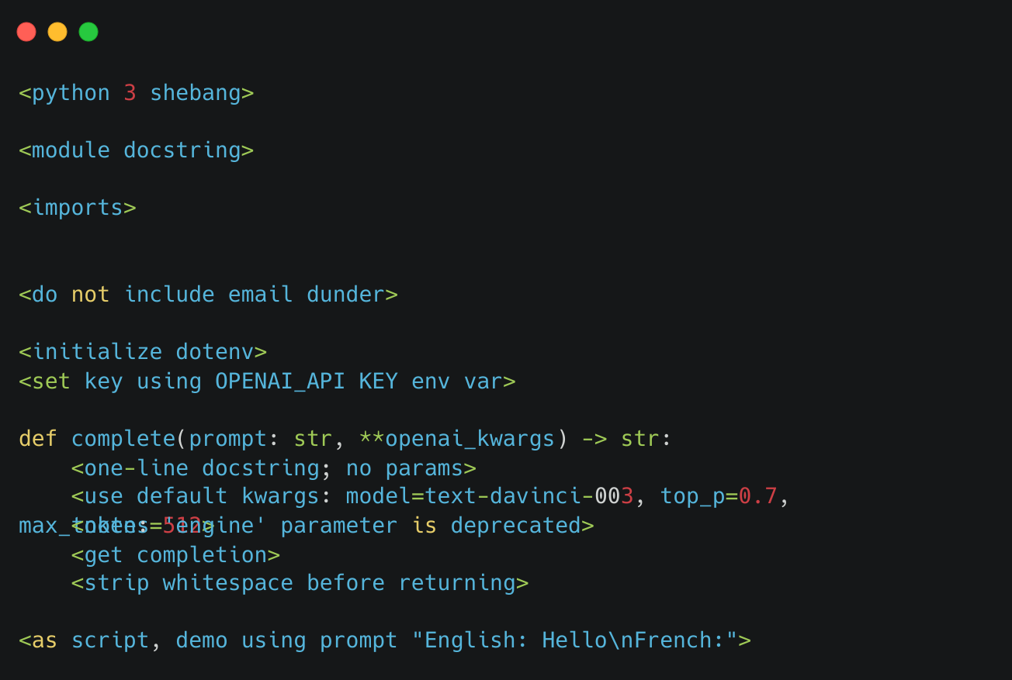
A Framework for Building Good Prompts
4
Operate on Structured Text
@goodside

Slide 66
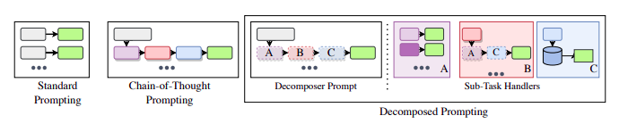
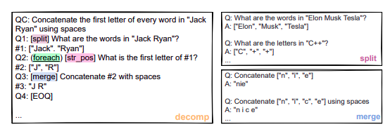
A Framework for Building Good Prompts
4
Operate on Structured Text
Introduce decomposition
Khot et al 2023

Slide 67
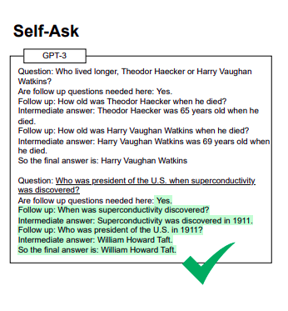
A Framework for Building Good Prompts
4
Operate on Structured Text
Introduce decomposition
Press et al 2023

Slide 68
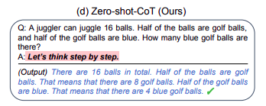
A Framework for Building Good Prompts
4
Operate on Structured Text
Introduce decomposition
Kojima et al 2023

Slide 69
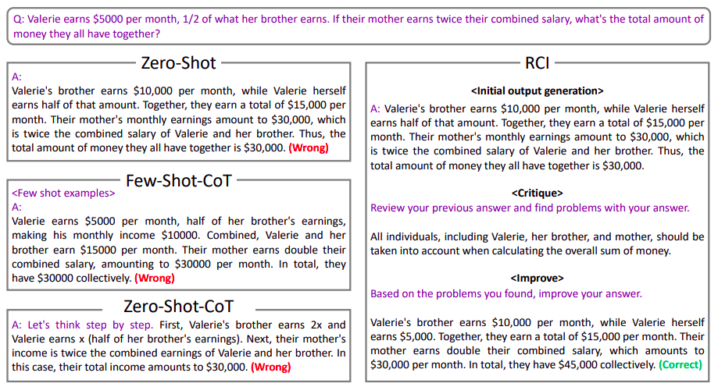
A Framework for Building Good Prompts
4
Operate on Structured Text
Introduce decomposition
Self-criticism
Kim, Baldi & McAleer 2023
Notes:
Ask the model to improve its answers

Slide 70
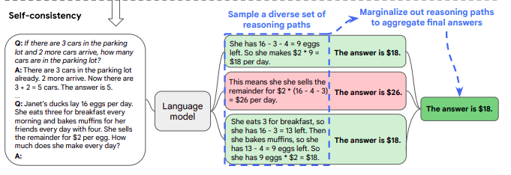
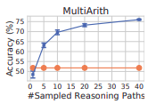
A Framework for Building Good Prompts
4
Operate on Structured Text
Introduce decomposition
Self-criticism
Ensembling
Wang et al 2023

Slide 71
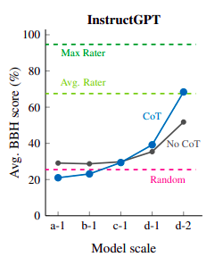
A Framework for Building Good Prompts
4
Operate on Structured Text
Introduce decomposition
Self-criticism
Ensembling
Combine for better performance!
Suzgun et al 2022
Notes:
Few-Shot Cot + "Let's think step by step" matches average human annotator performance on BIG Bench-Hard.

Slide 72
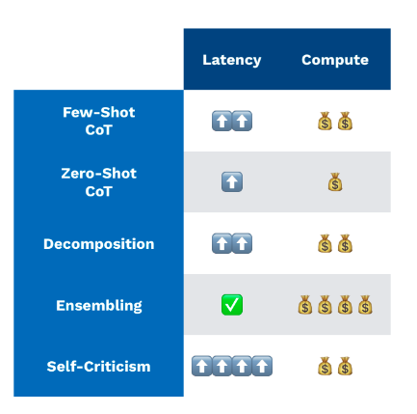
A Framework for Building Good Prompts
4
Operate on Structured Text
Introduce decomposition
Self-criticism
Ensembling
Be aware of quality-cost tradeoff!
FSDL LLM Bootcamp 2023
Notes:
Few-Shot Cot + "Let's think step by step" matches average human annotator performance on BIG Bench-Hard.

Slide 73
Exercise / Lab
Getting started with prompt engineering using the ChatGPT API
Extracting dates from unstructured data
Prompt engineering for text summarization and question answering

Slide 74
Fine Tuning ChatGPT Applications
3
A primer on how to fine tune ChatGPT on your data
Fine Tuning:
Notes:
discipline concerned with establishing the rules for obtaining the most deterministic outputs possible from a LLM by employing engineering techniques and protocols to ensure reproducibility and consistency.

Slide 75
Fine Tuning ChatGPT Applications
3
A primer on how to fine tune ChatGPT on your data
Fine Tuning: process of “specialising an LLM on your specific dataset”
Notes:
discipline concerned with establishing the rules for obtaining the most deterministic outputs possible from a LLM by employing engineering techniques and protocols to ensure reproducibility and consistency.

Slide 76
Fine Tuning ChatGPT Applications
3
A primer on how to fine tune ChatGPT on your data
Fine Tuning: process of “specialising an LLM on your specific dataset”
Why?
Notes:
discipline concerned with establishing the rules for obtaining the most deterministic outputs possible from a LLM by employing engineering techniques and protocols to ensure reproducibility and consistency.

Slide 77
Fine Tuning ChatGPT Applications
3
A primer on how to fine tune ChatGPT on your data
Fine Tuning: process of “specialising an LLM on your specific dataset”
Why? Better results on specific tasks, lower latency… See OpenAI docs
Notes:
discipline concerned with establishing the rules for obtaining the most deterministic outputs possible from a LLM by employing engineering techniques and protocols to ensure reproducibility and consistency.

Slide 78
Fine Tuning ChatGPT Applications
3
A primer on how to fine tune ChatGPT on your data
Fine Tuning: process of “specialising an LLM on your specific dataset”
Why? Better results on specific tasks, lower latency… See OpenAI docs
How?
Notes:
discipline concerned with establishing the rules for obtaining the most deterministic outputs possible from a LLM by employing engineering techniques and protocols to ensure reproducibility and consistency.

Slide 79
Fine Tuning ChatGPT Applications
3
A primer on how to fine tune ChatGPT on your data
Fine Tuning: process of “specialising an LLM on your specific dataset”
Why? Better results on specific tasks, lower latency… See OpenAI docs
How? By preparing a custom .jsonl dataset on your specific use case
Notes:
discipline concerned with establishing the rules for obtaining the most deterministic outputs possible from a LLM by employing engineering techniques and protocols to ensure reproducibility and consistency.

Slide 80
Fine Tuning ChatGPT Applications
3
A primer on how to fine tune ChatGPT on your data
Fine Tuning: process of “specialising an LLM on your specific dataset”
Why? Better results on specific tasks, lower latency… See OpenAI docs
How? By preparing a custom .jsonl dataset on your specific use case
The goal of fine tuning is to adapt the model to your specific use case by providing it with a few examples of successful interactions
Notes:
discipline concerned with establishing the rules for obtaining the most deterministic outputs possible from a LLM by employing engineering techniques and protocols to ensure reproducibility and consistency.

Slide 81
Fine Tuning ChatGPT Applications
3
Common Use Cases
Notes:
discipline concerned with establishing the rules for obtaining the most deterministic outputs possible from a LLM by employing engineering techniques and protocols to ensure reproducibility and consistency.

Slide 82
Fine Tuning ChatGPT Applications
3
Common Use Cases
Setting style, tone, format
OpenAI docs
Notes:
discipline concerned with establishing the rules for obtaining the most deterministic outputs possible from a LLM by employing engineering techniques and protocols to ensure reproducibility and consistency.

Slide 83
Fine Tuning ChatGPT Applications
3
Common Use Cases
Setting style, tone, format
Correcting failures
OpenAI docs
Notes:
discipline concerned with establishing the rules for obtaining the most deterministic outputs possible from a LLM by employing engineering techniques and protocols to ensure reproducibility and consistency.

Slide 84
Fine Tuning ChatGPT Applications
3
Common Use Cases
Setting style, tone, format
Correcting failures
Improving reliability
OpenAI docs
Notes:
discipline concerned with establishing the rules for obtaining the most deterministic outputs possible from a LLM by employing engineering techniques and protocols to ensure reproducibility and consistency.

Slide 85
Fine Tuning ChatGPT Applications
3
Common Use Cases
Setting style, tone, format
Handling edge cases
Correcting failures
Improving reliability
OpenAI docs
Notes:
discipline concerned with establishing the rules for obtaining the most deterministic outputs possible from a LLM by employing engineering techniques and protocols to ensure reproducibility and consistency.

Slide 86
Fine Tuning ChatGPT Applications
3
Common Use Cases
Setting style, tone, format
Handling edge cases
Correcting failures
Extracting structured output
Improving reliability
OpenAI docs
Notes:
discipline concerned with establishing the rules for obtaining the most deterministic outputs possible from a LLM by employing engineering techniques and protocols to ensure reproducibility and consistency.

Slide 87
Fine Tuning ChatGPT Applications
3
Common Use Cases
Setting style, tone, format
Handling edge cases
Correcting failures
Extracting structured output
Improving reliability
Function Calling
OpenAI docs
Notes:
discipline concerned with establishing the rules for obtaining the most deterministic outputs possible from a LLM by employing engineering techniques and protocols to ensure reproducibility and consistency.

Slide 88
Fine Tuning ChatGPT Applications
3
Basic Steps
OpenAI docs
Notes:
discipline concerned with establishing the rules for obtaining the most deterministic outputs possible from a LLM by employing engineering techniques and protocols to ensure reproducibility and consistency.

Slide 89
Fine Tuning ChatGPT Applications
3
Basic Steps
Prepare and upload training data
OpenAI docs
Notes:
discipline concerned with establishing the rules for obtaining the most deterministic outputs possible from a LLM by employing engineering techniques and protocols to ensure reproducibility and consistency.

Slide 90
Fine Tuning ChatGPT Applications
3
Basic Steps
Prepare and upload training data
Train a new fine-tuned model
OpenAI docs
Notes:
discipline concerned with establishing the rules for obtaining the most deterministic outputs possible from a LLM by employing engineering techniques and protocols to ensure reproducibility and consistency.

Slide 91
Fine Tuning ChatGPT Applications
3
Basic Steps
Prepare and upload training data
Train a new fine-tuned model
Use your fine-tuned model
OpenAI docs
Notes:
discipline concerned with establishing the rules for obtaining the most deterministic outputs possible from a LLM by employing engineering techniques and protocols to ensure reproducibility and consistency.

Slide 92
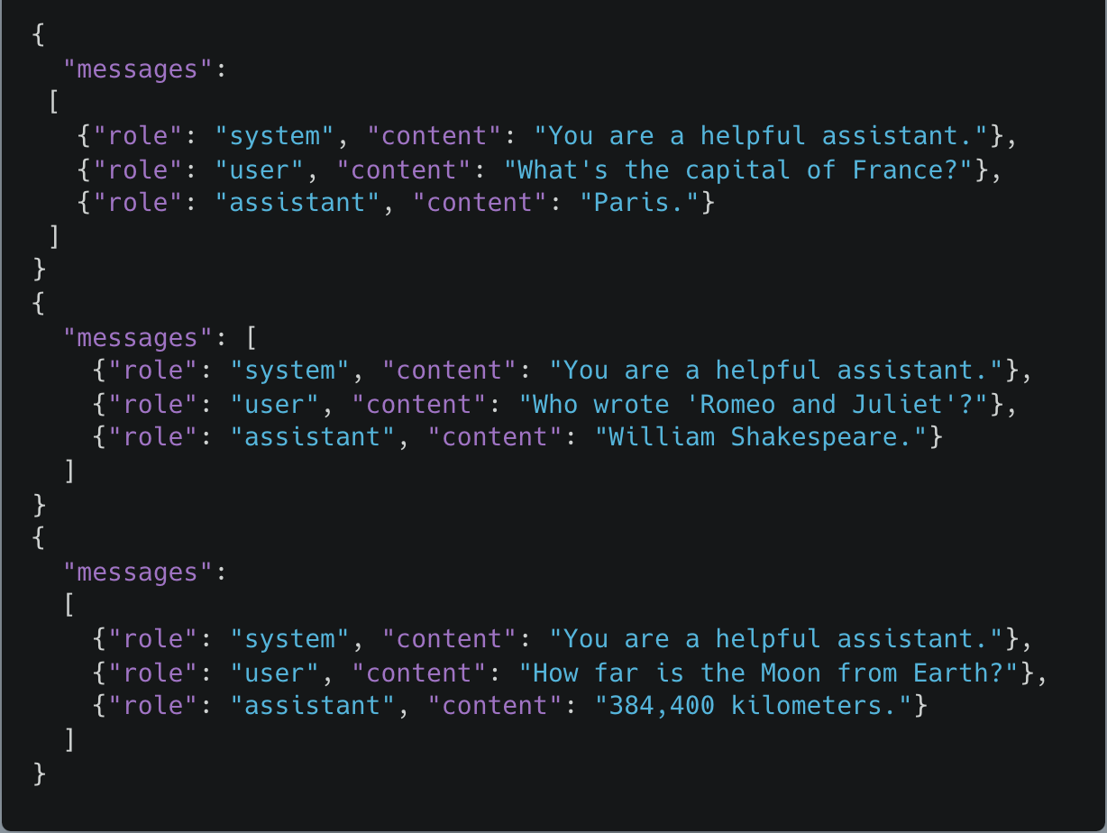
Fine Tuning ChatGPT Applications
3
Prepare and upload training data
Notes:
discipline concerned with establishing the rules for obtaining the most deterministic outputs possible from a LLM by employing engineering techniques and protocols to ensure reproducibility and consistency.

Slide 93
Fine Tuning ChatGPT Applications
3
Prepare and upload training data
Notes:
discipline concerned with establishing the rules for obtaining the most deterministic outputs possible from a LLM by employing engineering techniques and protocols to ensure reproducibility and consistency.

Slide 94
Fine Tuning ChatGPT Applications
3
Prepare and upload training data
Notes:
discipline concerned with establishing the rules for obtaining the most deterministic outputs possible from a LLM by employing engineering techniques and protocols to ensure reproducibility and consistency.

Slide 95
Fine Tuning ChatGPT Applications
3
Prepare and upload training data
Notes:
discipline concerned with establishing the rules for obtaining the most deterministic outputs possible from a LLM by employing engineering techniques and protocols to ensure reproducibility and consistency.

Slide 96
Fine Tuning ChatGPT Applications
3
Prepare and upload training data
Notes:
discipline concerned with establishing the rules for obtaining the most deterministic outputs possible from a LLM by employing engineering techniques and protocols to ensure reproducibility and consistency.

Slide 97
Fine Tuning ChatGPT Applications
3
Prepare and upload training data
Notes:
discipline concerned with establishing the rules for obtaining the most deterministic outputs possible from a LLM by employing engineering techniques and protocols to ensure reproducibility and consistency.

Slide 98
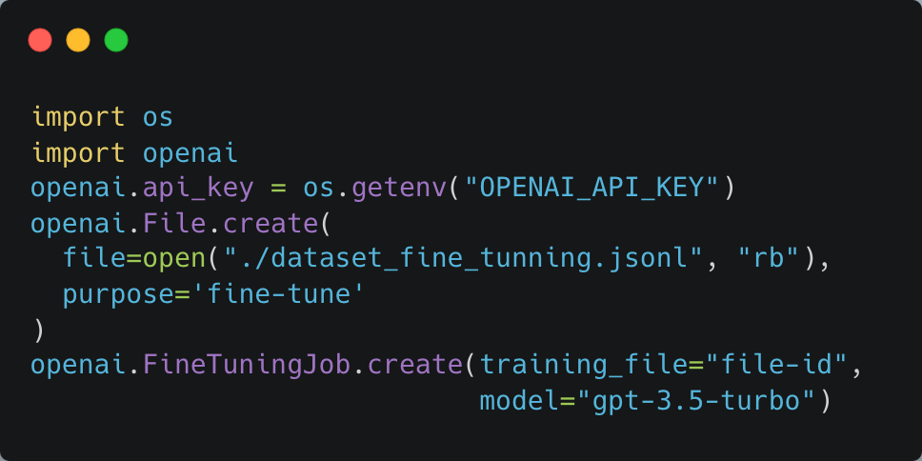
Fine Tuning ChatGPT Applications
3
Train a new fine-tuned model
Notes:
discipline concerned with establishing the rules for obtaining the most deterministic outputs possible from a LLM by employing engineering techniques and protocols to ensure reproducibility and consistency.

Slide 99
Fine Tuning ChatGPT Applications
3
Train a new fine-tuned model
Notes:
discipline concerned with establishing the rules for obtaining the most deterministic outputs possible from a LLM by employing engineering techniques and protocols to ensure reproducibility and consistency.

Slide 100
Fine Tuning ChatGPT Applications
3
Train a new fine-tuned model
Notes:
discipline concerned with establishing the rules for obtaining the most deterministic outputs possible from a LLM by employing engineering techniques and protocols to ensure reproducibility and consistency.

Slide 101
Fine Tuning ChatGPT Applications
3
Train a new fine-tuned model
Notes:
discipline concerned with establishing the rules for obtaining the most deterministic outputs possible from a LLM by employing engineering techniques and protocols to ensure reproducibility and consistency.

Slide 102
Fine Tuning ChatGPT Applications
3
Train a new fine-tuned model
Notes:
discipline concerned with establishing the rules for obtaining the most deterministic outputs possible from a LLM by employing engineering techniques and protocols to ensure reproducibility and consistency.

Slide 103
Fine Tuning ChatGPT Applications
3
Train a new fine-tuned model
Notes:
discipline concerned with establishing the rules for obtaining the most deterministic outputs possible from a LLM by employing engineering techniques and protocols to ensure reproducibility and consistency.

Slide 104
Fine Tuning ChatGPT Applications
3
Train a new fine-tuned model
Notes:
discipline concerned with establishing the rules for obtaining the most deterministic outputs possible from a LLM by employing engineering techniques and protocols to ensure reproducibility and consistency.

Slide 105
Fine Tuning ChatGPT Applications
3
Train a new fine-tuned model
Notes:
discipline concerned with establishing the rules for obtaining the most deterministic outputs possible from a LLM by employing engineering techniques and protocols to ensure reproducibility and consistency.

Slide 106
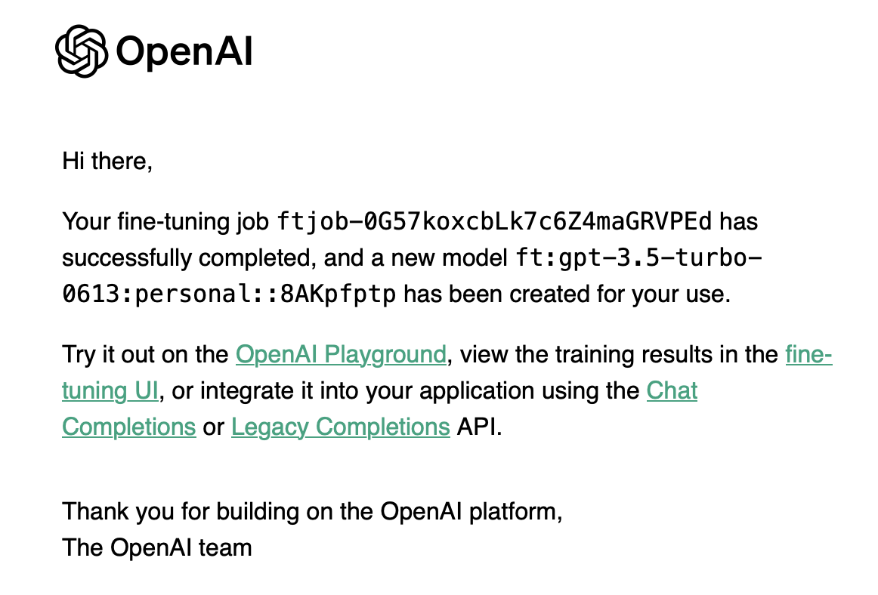
Fine Tuning ChatGPT Applications
3
Train a new fine-tuned model
Notes:
discipline concerned with establishing the rules for obtaining the most deterministic outputs possible from a LLM by employing engineering techniques and protocols to ensure reproducibility and consistency.

Slide 107
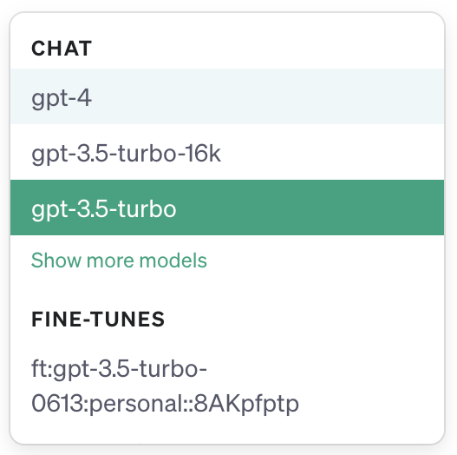
Fine Tuning ChatGPT Applications
3
Use your fine-tuned model
Notes:
discipline concerned with establishing the rules for obtaining the most deterministic outputs possible from a LLM by employing engineering techniques and protocols to ensure reproducibility and consistency.

Slide 108
Fine Tuning ChatGPT Applications
3
Lets practice!
Notebook demo
Notes:
discipline concerned with establishing the rules for obtaining the most deterministic outputs possible from a LLM by employing engineering techniques and protocols to ensure reproducibility and consistency.

Slide 109
Break

Slide 110
Langchain for LLM App Development
From static prompts to dynamic prompts

Slide 111
Langchain for LLM App Development
From static prompts to dynamic prompts
Prompt management workflows that require dynamic prompts

Slide 112
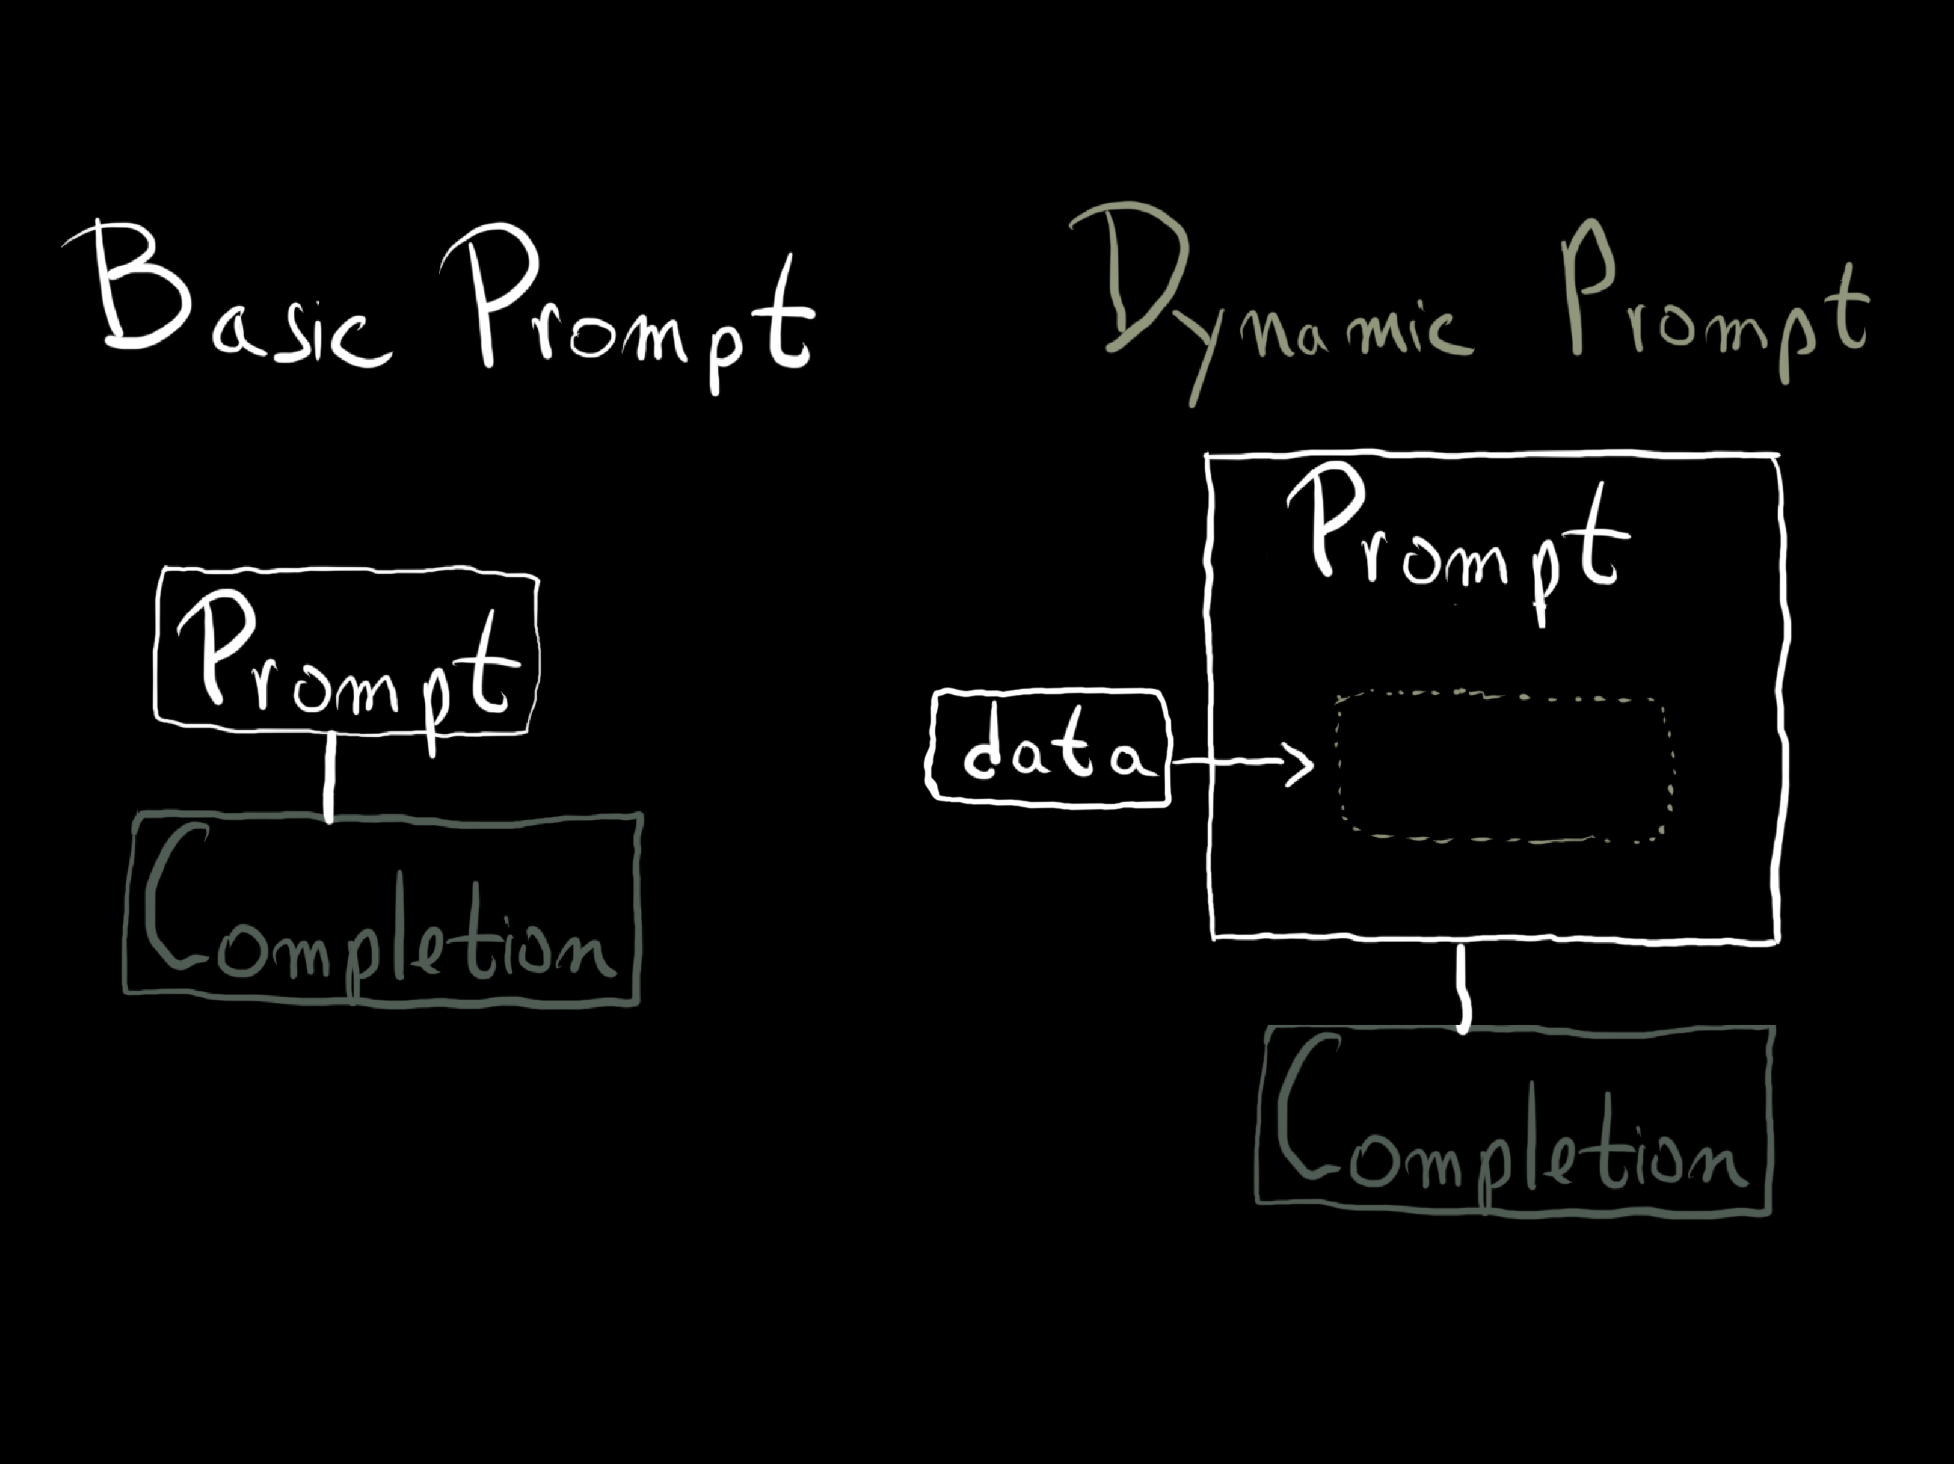
Langchain for LLM App Development
From static prompts to dynamic prompts
Prompt management workflows that require dynamic prompts
This dynamics requirement leads to the need for creating certain types of abstractions

Slide 113

Langchain for LLM App Development
Langchain framework
Langchain is a framework that facilitates the creation and management of dynamic prompts and chaining between prompts.
Main features: components and off-the-shelf-chains.

Slide 114
Langchain for LLM App Development
Langchain components
Notes:
For instance, if your API call uses 10 tokens for message input and receives 20 tokens in the message output, you'll be billed for a total of 30 tokens.

Slide 115
Langchain for LLM App Development
Langchain components
Models: abstractions over the LLM APIs like the ChatGPT API.
Notes:
For instance, if your API call uses 10 tokens for message input and receives 20 tokens in the message output, you'll be billed for a total of 30 tokens.

Slide 116
Langchain for LLM App Development
Langchain components
Models: abstractions over the LLM APIs like the ChatGPT API.
Prompts: “Prompt Templates” abstraction, output parsers.
Notes:
For instance, if your API call uses 10 tokens for message input and receives 20 tokens in the message output, you'll be billed for a total of 30 tokens.

Slide 117
Langchain for LLM App Development
Langchain components
Models: abstractions over the LLM APIs like the ChatGPT API.
Prompts: “Prompt Templates” abstraction, output parsers.
Indexes: Abstraction for interacting with documents (document loaders, text splitters, vector stores, retrievers).
Notes:
For instance, if your API call uses 10 tokens for message input and receives 20 tokens in the message output, you'll be billed for a total of 30 tokens.

Slide 118
Langchain for LLM App Development
Langchain components
Models: abstractions over the LLM APIs like the ChatGPT API.
Prompts: “Prompt Templates” abstraction, output parsers.
Indexes: Abstraction for interacting with documents (document loaders, text splitters, vector stores, retrievers).
Chains: Combination of prompt, LLM and output parsing
Notes:
For instance, if your API call uses 10 tokens for message input and receives 20 tokens in the message output, you'll be billed for a total of 30 tokens.

Slide 119
Langchain for LLM App Development
Langchain components
Models: abstractions over the LLM APIs like the ChatGPT API.
Prompts: “Prompt Templates” abstraction, output parsers.
Indexes: Abstraction for interacting with documents (document loaders, text splitters, vector stores, retrievers).
Chains: Combination of prompt, LLM and output parsing
Agents are outside the scope of this live-training
Notes:
For instance, if your API call uses 10 tokens for message input and receives 20 tokens in the message output, you'll be billed for a total of 30 tokens.

Slide 120
Langchain for LLM App Development
Models, Prompts and Output Parsers
Notebook demo

Slide 121
Langchain for LLM App Development
LLMChain & Sequential Chains
LLMChain & Sequential Chains
Chains of Prompts

Slide 122
Langchain for LLM App Development
LLMChain & Sequential Chains
LLMChain & Sequential Chains
input
output
SimpleSequentialChain: single input/output
Sequence of Chains

Slide 123
Langchain for LLM App Development
LLMChain & Sequential Chains
LLMChain & Sequential Chains
chain 1
chain 2
output
SimpleSequentialChain: single input/output
input
chain 3
chain 4
SequentialChain: multiple inputs/outputs
Notebook demo

Slide 124


Langchain for LLM App Development
Langchain with Documents
LLMs have a limited context length
LLM

Slide 125
Langchain for LLM App Development
Langchain with Documents
LLMs have a limited context length
Embeddings: capture content and meaning
Embeddings
[0.1,0.0456,….]

Slide 126
Langchain for LLM App Development
Langchain with Documents
LLMs have a limited context length
My dog likes food
Embeddings
[0.1,0.0456,….]
Embeddings: capture content and meaning
My cat hates waking up
Embeddings
[0.004,0.06,….]
I love programming
Embeddings
[0.7,0.0135,….]

Slide 127
Langchain for LLM App Development
Langchain with Documents
Similar
LLMs have a limited context length
My dog likes food
Embeddings
[0.1,0.0456,….]
Similar
Embeddings: capture content and meaning
My cat hates waking up
Embeddings
[0.004,0.06,….]
Not similar
I love programming
Embeddings
[0.7,0.0135,….]

Slide 128
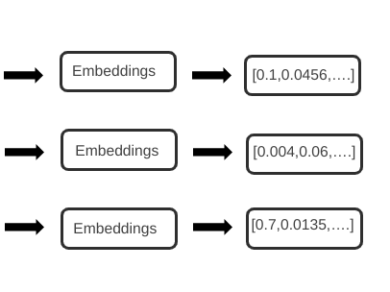
Langchain for LLM App Development
Langchain with Documents
LLMs have a limited context length
chunk
chunk
Embeddings: capture content and meaning
chunk
Vector DBs
Query

Slide 129
Langchain for LLM App Development
Langchain with Documents
Chunking methods for large docs
LLMs have a limited context length
Map_reduce
Embeddings: capture content and meaning
Refine
Vector DBs
Map_rerank
Notebook demo

Slide 130
Langchain for LLM App Development
Evaluation with Langchain
Notebook demo

